Slide 1
MP Real-Time Scheduling

Slide 2
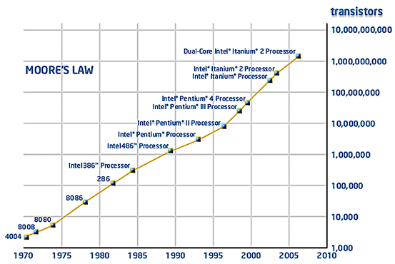
As Moore’s law goes on…
Number of transistor/chip doubles every 18 to 24 mm
Notes:
the number of transistors that can be inexpensively placed on an integrated circuit is increasing exponentially, doubling approximately every two years
Patterson & Hennessy: number of cores will double every 18 months, while power, clock frequency and costs will remain constant

Slide 3
…heating becomes a problem
P → V → f: Clock speed limited to less than 4 GHz
Power (W)
Pentium Tejas
cancelled!
Nuclear
Reactor
P4
STOP
P3
Pentium
P1
P2
Hot-plate
286
486
8086
386
8085
8080
8008
4004
Year

Slide 4
Keeping Moore’s law alive
Exploit the immense number of transistors in other ways
Reduce gate sizes while keeping CPU frequency relatively low
Use a higher number of slower logic gates
In other words:
Switch to Multicore processor!

Slide 5
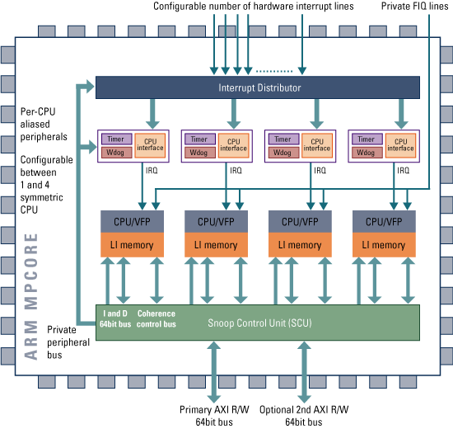
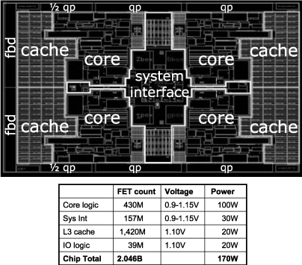
Solution
Use a higher number of slower logic gates
Denser chips with transistor operating at lower frequencies
MULTICORE SYSTEMS

Slide 6
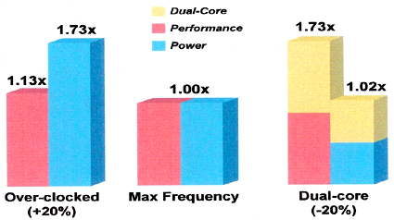
Multicore Motivations
1. Standard processor over-clocked 20% 2. Standard processor 3. Two standard processors each under-clocked 20%
Notes:
Two or more processor cores on the same chip
Intel Core Duo processor
Semiconductor trends
More transistors available per die
Clock scaling reaching limits due to power constraints. An empirical study suggests that a 1% clock increase results in a 3% power increase.
Moore’s Law has hit a wall due to power constraints

Slide 7
The Multicore invasion
Intel’s Core2, Itanium, Xeon: 2, 4 cores
AMD’s Opteron, Athlon 64 X2, Phenom: 2, 4 cores
IBM-Toshiba-Sony Cell processor: 8 cores (PSX3)
Microsoft’s Xenon: 3 cores (Xbox 360)
ARM’s MPCore: 4 cores
Sun’s Niagara UltraSPARC: 8 cores
Tilera’s TILE64: 64-core
Nios II: x soft Cores
TI, Freescale, Atmel, Broadcom,Picochip (picoArray up to 300 DSP cores), ...
Notes:
Network Processors andare being replaced by multicore chips (Broadcom)
DSP
Picochip: communication domain

Slide 8
Task Model
Independent periodic taskset with n tasks
For each task τ_{i}
Ci: Worst-Case Execution Time
Di: Relative deadline
Ti: Period
Each task consists of an infinite sequence of jobs
The k^{th} job of task τ_{i} is denoted j_{i}^{k}

Slide 9
Multiprocessor models
identical multiprocessors:
each processor has the same computing capacity
uniform multiprocessors:
different processors have different computing capacities
heterogeneous multiprocessors:
each (task, processor) pair may have a different computing capacity

Slide 10
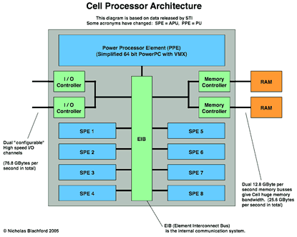
Identical vs heterogenous cores
ARM’s MPCore
IBM Cell Processor
4 identical ARMv6 cores
One Power Processor Element (PPE)
8 Synergistic Processing Element (SPE)

Slide 11
Multiprocessor Models
Identical multiprocessors: each processor has the same speed
Task T1
Task T2
P1
P2
P3
background – problem – results

Slide 12
Multiprocessor Models
Uniform multiprocessors: different processors have different speeds
Task T1
Task T2
y
y/2
y/3
x
x/2
x/3
P1
P2
P3
speed = 1
speed = 2
speed = 3
background – problem – results

Slide 13
Multiprocessor Models
Heterogeneous multiprocessors: each (task, processor) pair may have a different relative speed, due to specialized processor architectures
Task T1
Task T2
y
y
1.5 y
Number-crunching task:
x
x/2
x/2
x/3
x/3
Graphics-intensive task:
CPU
DSP chip
Graphics co-processor
background – problem – results

Slide 14
MP Scheduling
Many NP-hard problems
Few optimal results
Heuristic approaches
Only sufficient schedulability tests
Active research topic

Slide 15
Global vs partitioned scheduling
Global scheduling
All ready jobs are kept in a common (global) queue; when selected for execution, a job can be dispatched to an arbitrary processor, even after being preempted
Partitioned scheduling
Each task may only execute on a specific processor
Global scheduling:
Single system-wide queue
Partitioned scheduling:
per-processor queues
CPU1
τ₁
CPU1
τ₁
τ₅
τ₄
τ₁
τ₅
τ₄
τ₃
τ₂
τ₁
CPU2
τ₂
τ₃
τ₂
CPU2
τ₂
CPU3
τ₃
CPU3
Notes:
A task may execute on any processor
A preempted job may resume on any processor
All ready tasks are kept in a common (global) queue
When selected for execution, a task can be dispatched to an arbitrary processor, even after being preempted
Single system-wide queue or multiple per-processor queues:

Slide 16
Global Scheduling
Advantages:
Supports load-balancing
More effective utilization of processors
Unused processor time can easily be reclaimed
More effective slack reclaiming and overload management
Supported by most multiprocessor operating systems
Windows, Linux, MacOS...
Disadvantages:
Migration cost: can be mitigated by proper HW (e.g., MPCore’s Direct Data Intervention)
Few schedulability tests → Active research topic
Notes:
Easier re-scheduling (dynamic loads, selective shutdown, etc.)
Number of preemptions
Weak theoretical framework
• Poor resource utilization for hard timing constraints
– No more than 50% resource utilization can be guaranteed
• Suffers from several scheduling anomalies
– Sensitive to period adjustments
Lower average response time

Slide 17
Partitioned scheduling
Advantages:
Mature scheduling framework
Uniprocessor scheduling theory scheduling are applicable
Uniprocessor resource access protocols (PIP, PCP…) can be used
Partitioning of tasks can be automated
e.g., with bin-packing algorithm
Disadvantages:
No load-balancing
Surplus CPU time cannot be shared among processors
Notes:
cannot exploit all unused execution time

Slide 18

Partitioned Scheduling
The scheduling problem reduces to:
Bin-packing
problem
+
Uniprocessor
scheduling
problem
τ₁
τ₃
τ₅
τ₂
τ₄
NP-hard
Well known
Various heuristics algorithms
First Fit (FF)
Best Fit (BF)
Worst Fit (WF)
Next Fit (NF)
EDF
U_{tot} ≤ 1
RM
(RTA)
...
Notes:
FF, NF, BF, FFDU, BFDD, etc.
in the
strong sense
Global (work-conserving) and partitioned approaches are incomparable
Two steps:
1. Determine a mapping of tasks to processors
2. Perform run-time scheduling
The Earliest Deadline First (EDF) scheduling algorithm
- provably optimal (utilization bound = 1.0) on uniprocessors
Partitioned with EDF 
Assign tasks to the processors, such that no processor’s capacity is exceeded
Schedule each processor using EDF

Slide 19
Partitioned Scheduling
Bin-packing algorithms:
– The problem concerns packing objects of varying sizes in boxes (”bins”) with the objective of minimizing number of used boxes.
Application to multiprocessor systems:
– Bins are represented by processors and objects by tasks.
– The decision whether a processor is ”full” or not is derived from a utilization-based feasibility test.
Assumptions:
– Independent, periodic tasks
– Preemptive, uniprocessor scheduling (RM)

Slide 20
Partitioned scheduling
Complexity of schedulability analysis for partitioned scheduling: (Leung & Whitehead, 1982)
The problem of deciding whether a task set is schedulable on m processors with respect to partitioned scheduling is NP-complete
Consequence:
There cannot be any pseudo-polynomial time algorithm for finding an optimal partition of a set of tasks unless P = NP.

Slide 21
Example: RMFF
Rate-Monotonic-First-Fit (RMFF): (Dhall and Liu, 1978)
Let the processors be indexed as 1, 2, …
Assign the tasks in the order of increasing periods (that is, RM order).
For each task Ti, choose the lowest previously-used processor j such that Ti, together with all tasks that have already been assigned to processor j, can be feasibly scheduled according to the utilization-based RM-feasibility test.
Additional processors are added if needed.

Slide 22
Our Assumptions for Global Scheduling
Identical multiprocessors
Work-conserving:
At each instant, the highest-priority jobs that are eligible to execute are selected for execution upon the available processors.
a processor is never left idle while an active job exists (unless migration constraints prevent the task from executing on the idle processor
Notes:
Task execution is assumed to be ”greedy”:
If higher-priority tasks occupy all processors, a lower-priority task cannot grab a processor until the execution of a higher priority task is complete.
Task execution is assumed to be ”greedy”:
If higher-priority tasks occupy all processors, a lower-priority task cannot grab a processor until the execution of a higher priority task is complete.

Slide 23
Additional Assumptions
Independent tasks
Preemption and Migration support
For global schedulers, a preempted task can resume its execution on a different processor with 0 overhead
Cost of preemption/migration integrated into task WCET
No job-level parallelism
the same job cannot be simultaneously executed on more than one processor
Notes:
The independence assumtion can be later removed, considering blocking times and shared resource protocols.

Slide 24
Source of Difficulty
The “no job-level parallelism” assumption leads to difficult scheduling problems
“The simple fact that a task can use only one processor even when several processors are free at the same time adds a surprising amount of difficulty to the scheduling of multiple processors” [Liu’69]
CPU1
CPU2
CPU3
Notes:
The ”root of all evil” in global scheduling: (Liu, 1969)
Few of the results obtained for a single processor generalize directly to the multiple processor case; bringing in additional processors adds a new dimension to the scheduling problem. The simple fact that a task can use only one processor even when several processors are free at the same time adds a surprising amount of difficulty to the scheduling of multiple processors.

Slide 25
Global scheduling example
CPU1
τ₁
Global queue
(ordered according to a given policy)
CPU2
τ₅
τ₄
τ₃
τ₂
τ₁
τ₂
CPU3
τ₃
The first m tasks are scheduled upon the m CPUs
Notes:
There is a global queue in which ready tasks ready are placed, according to a certain policy. When there is a free CPU the first task is removed from the queue and is scheduled. When a new task arrives with priority higher than one of the executing tasks, it preempts the executing task with lowest priority. If a task on a different CPU finishes its execution, the preempted task can “migrate” to the free CPU and continue its execution.

Slide 26
Global scheduling example
CPU1
τ₁
Global queue
(ordered according to a given policy)
CPU2
τ₅
τ₄
τ₂
τ₅
τ₃
τ₃
τ₄
τ₂
τ₂
τ₁
τ₁
CPU3
τ₃
τ₄
When a task finishes its execution, the next one in the queue is scheduled on the available CPU

Slide 27
Global scheduling example
CPU1
τ₁
Global queue
(ordered according to a given policy)
CPU2
τ₅
τ₅
τ₂
τ₄
τ₃
τ₄
τ₃
τ₃
τ₂
τ₂
τ₁
τ₁
τ₃
CPU3
τ₄
τ₃
When a higher priority task arrives, it preempts the task with lowest priority among the executing ones

Slide 28
Global scheduling example
CPU1
τ₁
τ₄
Global queue
(ordered according to a given policy)
CPU2
τ₅
τ₄
τ₂
τ₅
τ₃
τ₄
τ₃
τ₃
τ₄
τ₂
τ₃
τ₁
τ₂
Task τ₄ “migrated” from
CPU3 to CPU1
CPU3
τ₄
τ₃
When another task ends its execution, the preempted task can resume its execution

Slide 29
Global scheduling
The m highest priority ready jobs are always executing
Work-conserving scheduler
No processor is ever idle when the ready queue is non-empty
CPU1
τ₁
CPU2
τ₂
τ₅
τ₄
τ₃
τ₂
τ₁
CPU3
τ₃

Slide 30
Global vs. Partitioned
Global (work-conserving) and partitioned scheduling algorithms are incomparable:
There are tasksets that are schedulable with a global scheduler, but not with a partitioned scheduler, and vice versa.

Slide 31
Global vs Partitioned (FP)
A taskset schedulable with global scheduling, but not partitioned scheduling
τ₁ =(1,2); τ₂ =(2,3); τ₃ =(2,3)
Global FP scheduling w/ priority assignment p₁>p₂>p₃
One possible execution trace (another legal trace is for T1 to always stay on Processor 1):
Also feasible for priority assignment p₂>p₁>p₃

Slide 32
Global vs Partitioned (FP)
A taskset schedulable with partitioned scheduling, but not global scheduling
Example: τ₁=(4,6); τ₂=(7,12); τ₃=(4,12); τ₄=(10,24), τ₁ and τ₃ are assigned to Processor 1; τ₂ and τ₄ are assigned to Processor 2
Execution trace w/ partitioned FP scheduling w/ RM priority assignment (p₁>p₂>p₃>p₄)

Slide 33
Global vs Partitioned (FP)
Global FP scheduling w/ priority assignment p₁>p₂>p₃>p₄:
τ₁=(4,6); τ₂=(7,12); τ₃=(4,12); τ₄=(10,24)

Slide 34
Difficulties of Global Scheduling
Dhall’s effect:
With RM, DM and EDF, some low-utilization task sets can be unschedulable regardless of how many processors are used.
Dependence on relative priority ordering:
Changing the relative priority ordering among higher-priority tasks may affect schedulability for a lower-priority task.
Hard-to-find critical instant:
A critical instant does not always occur when a task arrives at the same time as all its higher-priority tasks.
Scheduling anomalies
Decreasing task execution time or increasing task period may cause deadline misses
Notes:
A critical instant does not always occur when a task arrives at the same time as all its higher-priority tasks.

Slide 35
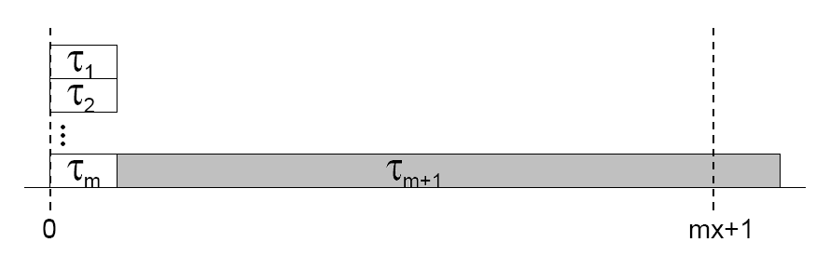
Dhall’s effect
Example: m processors, n=m+1 tasks, D_{i} = T_{i}
τ₁ ,…, τ_{m} = (1,T-1) τ_{m+1} = (T,T)
m light tasks
1 heavy task
U_{tot}→1
DEADLINE
MISS
T
Global RM/DM/EDF can fail at very low utilization
One solution: assign higher priority to tasks with
higher utilization
Notes:
Observation: RM, DM and EDF only account for task periods!
Execution times are not considered.
Solution: Dhall’s effect can be avoided by assigning higher priority to tasks with higher utilization

Slide 36
Priority Assignment
Impact of relative priority ordering:
Response time of a task depends on the relative priority ordering of higher-priority tasks
Not true for a uniprocessor system
This means that well-known uniprocessor methods for finding optimal priority assignments (e.g., Audsley, 1991) cannot be applied
Consequence:
New methods for constructing optimal multiprocessor priority assignments are needed!

Slide 37
Priority Assignment

Slide 38
Priority Assignment

Slide 39
Priority Assignment

Slide 40
Feasibility Test

Slide 41
Avoiding Dhall’s effect

Slide 42
Hard-to-find critical instant
A critical instant does not always occur when a task arrives at the same time as all its higher-priority tasks.
Finding the critical instant is a difficult problem
Recall that knowledge about the critical instant is a fundamental property in uniprocessor feasibility tests.
Consequence:
New methods for constructing effective multiprocessor feasibility tests are needed

Slide 43
Critical-Instant Example

Slide 44
MP Scheduling Anomalies
Decrease in processor demand (decreasing task execution time or increasing task period) may cause deadline misses!
Anomaly 1
Decrease in processor demand from higher-priority tasks can increase the interference on a lower-priority task because of change in the time when the tasks execute
Anomaly 2
Decrease in processor demand of a task negatively affects the task itself because change in the task arrival times cause it to suffer more interference
Notes:
EDF does not suffer from execution-time anomalies, but does suffer from period anomalies.

Slide 45
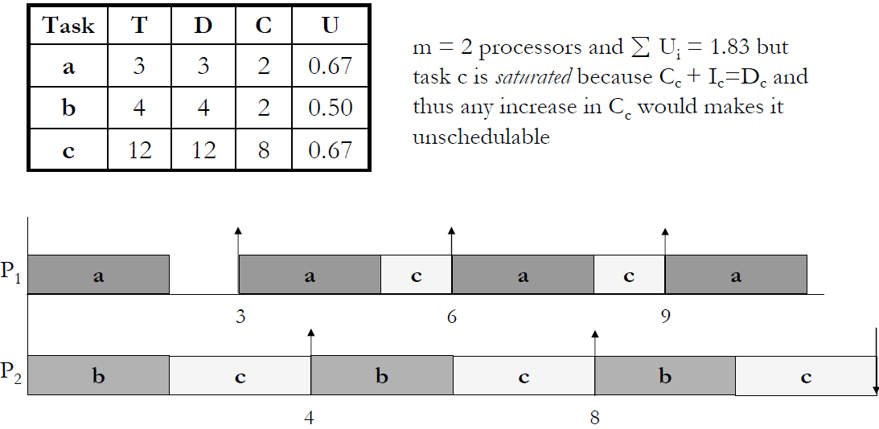
Anomaly 1

Slide 46
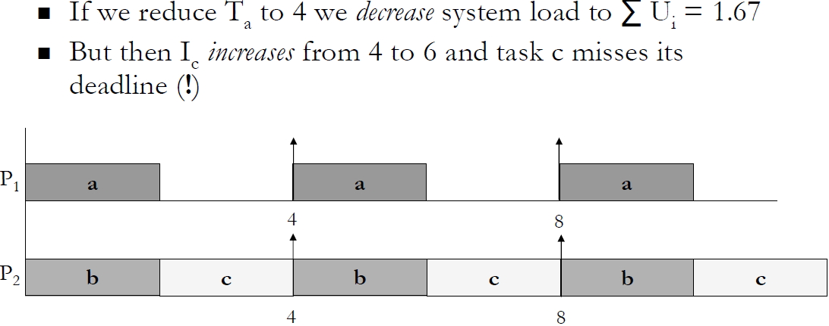
Anomaly 1

Slide 47
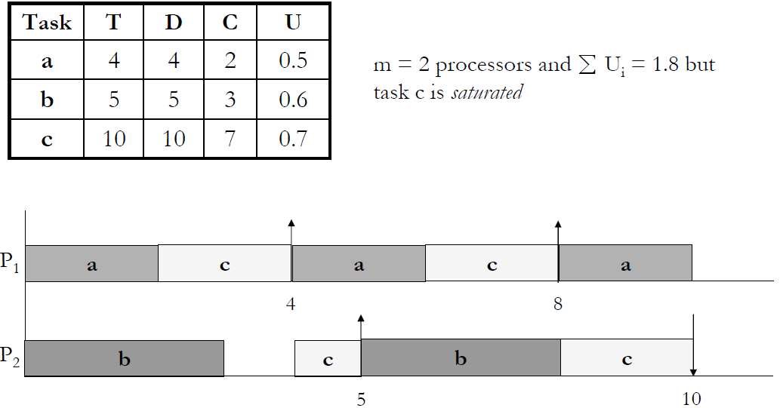
Anomaly 2

Slide 48
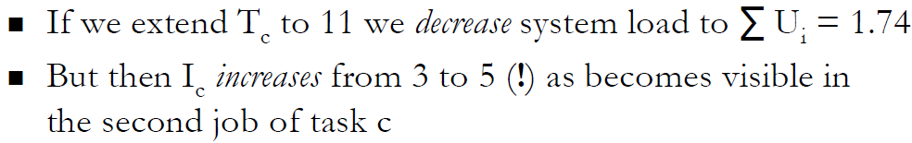
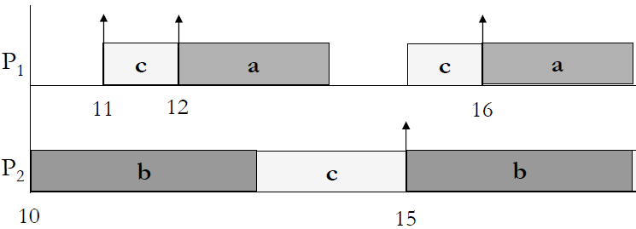
Anomaly 2
C’s deadline
missed here
a
c
c
b
20
23
Another example where the critical instant for task c does not occur at time 0 when it arrives at the same time as all its higher-priority tasks.

Slide 49
PFair Scheduling

Slide 50
PFair Scheduling Properties
Pfair algorithms are optimal for (periodic and sporadic) systems with implicit deadlines (deadline = period) on uni- and multiprocessor
Pfairness satisfied ⇒ deadlines are met for the periodic scheduling problem
Real-time scheduling algorithms based on proportionate fairness offers:
low output jitter
peaceful coexistence of real-time and non-real-time tasks
Notes:
Goal: schedule on a multiprocessor a set of periodically arriving hard real-time tasks with constant execution time in order to meet deadlines
”fairness for free”

Slide 51
Pfair Scheduling
Based on GPS (Generalized Processor Sharing), with a lag bounded by one
In any interval t, a task with utilization U will execute for an amount W, with U_{t}-1 < W < U_{t}+1
Different Pfair algorithms (PF, PD, PD²) [Anderson et al.]
All these algorithms incur large number of preemptions/migrations
Notes:
Other optimal algorithms: LLREF, EKG, BF

Slide 52
Task Model

Slide 53
Task Model

Slide 54
Proportional Progress

Slide 55
Question
Is there a schedule that only context-switches tasks at integer boundaries?

Slide 56
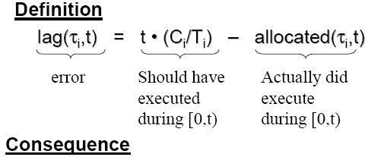
Proportional Progress

Slide 57
Allocation error with respect to the ideal system
lag(T, t, S) = ideal(T, t) – actual(T, t, S)
Positive ≡ behind, negative ≡ ahead, zero ≡ punctual
allocation error
for task T at
time t
total allocation
to T in the ideal
schedule over [0,t)
total allocation to T in the
schedule under
consideration over [0,t)

Slide 58
Example: Task T with wt(T) = 3/8
Ideal
Allocation
1
3/8
Possible
allocations
to a periodic
task
0
1
2
3
4
5
6
7
8
9
10
11
12
13
14
15
16
2
Lag
1
0
-1
-2

Slide 59
Ideal
Allocation
1
3/8
Possible
allocations
to a periodic
task
0
1
2
3
4
5
6
7
8
9
10
11
12
13
14
15
16
2
A schedule is Pfair iff
(∀T, t :: −1 < lag(T, t) < 1)
Lag
1
0
-1
-2

Slide 60
Lag of a Periodic Task
Lag(T,u) = ideal share of T in [0,u) – Pfair(T,u).
lag(T, u) < 0 ⇒ T is over-allocated at time u.
lag(T, u) > 0 ⇒ T is under-allocated at time u.
6
5
4
3
2
1
0
ideal
total share of task with weight 3/5.
Pfair
Over-allocated
Under-allocated
0 1 2 3 4 5 6 7 8 9 10 11
time

Slide 61
proportionate progress

Slide 62
How far from zero can the lag be?

Slide 63
PFairness

Slide 64
Scheduling of Periodic Tasks
Share of T in ideal schedule in [0,u) = ( ) × u.
lag(T, u) = – Pfair(T, u).
If p divides u, then lag is an integer.
–1< lag < 1 ⇒ lag = 0.
Hence, all jobs meet their deadlines.

Slide 65
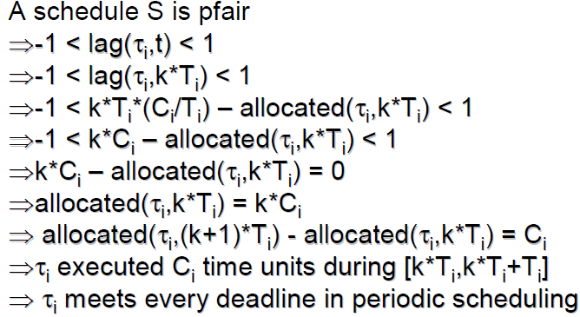
More Formal Proof of PFairness

Slide 66
Pfairness ensured by
Scheduling subtasks
Each task is broken into a sequence of quantum-length subtasks.
Time-driven, quantum-based scheduling
Scheduling decisions at quantum boundaries.
Time is integral, measured in units of quanta.
Interval [i, i+1) – is i^{th} quantum or time slot.
Schedules at most M subtasks (M – no. of processors).
Task migrations are allowed.

Slide 67
Scheduling of Subtasks
Each task is effectively divided into a series of quantum-length subtasks.
TIME 1 2 3 4 5 6 7
Subtask 3
Subtask 2
Subtask 1
Consider
a task T of
weight 3/7.
lag = 9/7
lag(T, 3) = (3/7) × 3 – 0 = 9/7 > 1
So the first subtask must finish by time 3.

Slide 68
Scheduling of Subtasks
TIME 1 2 3 4 5 6 7
Subtask 3
Subtask 2
Subtask 1
lag = 8/7
lag(T, 5) = (3/7) × 5 – 1 = 8/7 > 1
So the second subtask must finish by time 5.

Slide 69
Scheduling of Subtasks
TIME 1 2 3 4 5 6 7
Subtask 3
Subtask 2
Subtask 1
lag = –8/7
lag(T, 2) = (3/7) × 2 – 2 = –8/7 < –1
So the second subtask cannot be scheduled at time 1.

Slide 70
Pfair Windows
The lag bounds define evenly-spaced windows in which each subtask must execute.
TIME 1 2 3 4 5 6 7 8 9 10 11 12 13 14
Window 3
Window 2
Window 1
Thus, each subtask has a release-time and a deadline.

Slide 71
PF Runtime Algorithm

Slide 72
END

Slide 73
Demand Bound Function

Slide 74
Definition of DBF
DBF(Tau_{i}, t)=max cumulative execution requirement of jobs of sporadic task Tau_{i} in any internal of length t.
load(Tau, t)=
Result: Any sporadic task system Tau is EDF-schedulable on a preemptive uniprocessor if load(Tau) ≤ ln_{e}2
Result: Liu and Layland
Result: Any sporadic task system is DM-schedulable on a preemptive uniprocessor if load(Tau) ≤ 0.567 (solution to the equation … )

Slide 75
Response Time Analysis

Slide 76
Scheduling Anomaly Example 1
Doubling processor speed causes T₁ to miss its deadline
(Yellow part denotes a critical section shared by T₁ and T₂) _
Notes:
This is a good example to show you cannot simply round up exe time to its ceiling in MP scheduling.

Slide 77
Scheduling Anomaly Example 2
Increasing T₁’s period from 4 to 5 causes T₁ to miss its deadline
Notes:
This is an example to show you cannot take the floor of task period.

